Slide 1
Miscimetry in Reactive Transport
TR Ginn, WSU 2020
Differential Algebraic Equation (DAE) models of reactive transport impacted by mixing two examples: aerobic biodegradation, MICP Exposure time of mixtures three examples: solution to solid = groundwater age solute to some solid = chemical heterogeneity solute to its own gradient = scalar dissipation

Slide 2
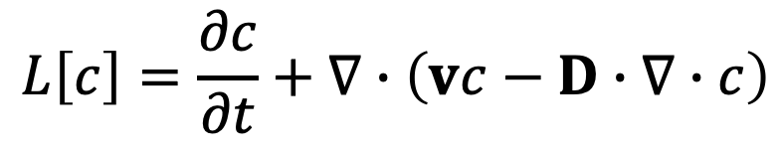
DAE Systems
$$L\left[c\right]=\frac{∂c}{∂t}+∇∙\left(vc−D∙∇∙c\right)$$
L[ ] Transport
operator
Rates of
kinetically-
controlled
reactions
C^{I} Primary
species
=
Rates of
fast (at
equilibrium)
reacations
C^{II} Secondary
species
Stoichiometry matrix
Ginn et al WRR 2017 https://doi.org/10.1002/2017WR020759

Slide 3


Example 1: Aerobic Biodegradation
Simplified reaction network for aerobic biodegradation of benzoate with growth
In reality biomass decays, may be kinetically planktonic vs. sessile
R₁: Benzoate + F O₂ => Y Biomass + CO₂
R₂: H₂CO₃ ⬄ H₂O + CO₂
R₃: HCO₃⁻ ⬄ H₂O + CO₂ - H⁺
R₄: CO₃⁻⁻ ⬄ H₂O + CO₂ - 2H⁺
$$R_{K}$$
$$R_{E}$$

Slide 4


Example 1: Aerobic Biodegradation
This reaction is mixing-limited and occurs only where both
Oxygen and Benzoate are co-located
R₁: Benzoate + F O₂ => Y Biomass + CO₂
R₂: H₂CO₃ ⬄ H₂O + CO₂
R₃: HCO₃⁻ ⬄ H₂O + CO₂ - H⁺
R₄: CO₃⁻⁻ ⬄ H₂O + CO₂ - 2H⁺
0.2-5.0 mg/mg
$$R_{K}$$
$$R_{E}$$
300 mg/l
Benzoate
8 mg/l
Oxygen

Slide 5
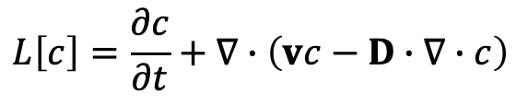
Example 1: Aerobic Biodegradation
$$L\left[c\right]=\frac{∂c}{∂t}+∇∙\left(vc−D∙∇∙c\right)$$
Reactive transport equations
(transport is advection-dispersion,
assuming dispersion is equivalent to mixing)
9 species
Benzoate
Oxygen
Biomass
CO₂
H+
H₂O
H₂CO₃
HCO₃-
CO₃--
C₁
C₂
C₃
C₄
C₅
C₆
C₇
C₈
C₉
6 primary
species
3 secondary
species

Slide 6
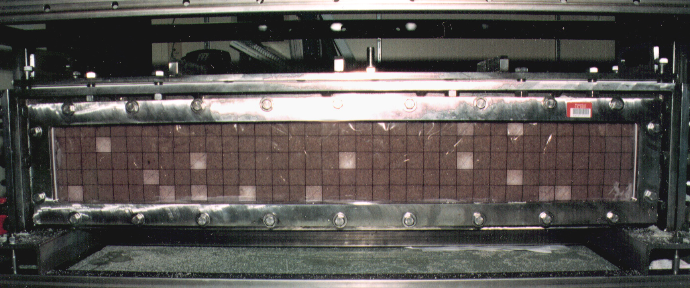
Murphy et al. WRR 1995 https://doi.org/10.1029/96WR03851,
Ginn et al JCH 2001 https://doi.org/10.1016/S0169-7722(00)00167-4

Slide 7
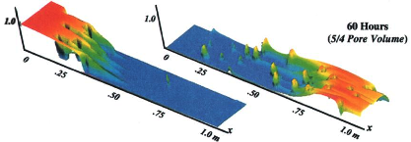
Oxygen
Benzoate

Slide 8
Oxygen
Benzoate
Upscaled to 1D ?

Slide 9


Example 2: MICP (Microbially-Induced Calcite Precipitation
Reaction network for aerobic ureolysis leading to carbonate/pH production: with enough Ca⁺2
In reality Calcite may precipitate kinetically
R₁: H₂N(CO)NH₂ + H⁺ + 2H₂O ⬄2NH₄⁺ + HCO₃⁻
R₂: 2 NH₄⁺ + Ca[2X] ⬄ Ca⁺⁺ + 2 Na[X]
R₃: CaCO₃ ⬄ Ca⁺⁺ + CO₃—
R₄: H₂CO₃ ⬄ H₂O + CO₂
R₅: HCO₃⁻ ⬄ H₂O + CO₂ - H⁺
R₆: CO₃⁻⁻ ⬄ H₂O + CO₂ - 2H⁺
R₇: . . .
$$R_{K}$$
$$R_{E}$$
Barkouki et al., 2011 TiPM https://doi.org/10.1007/s11242-011-9804-z
Nassar et al., 2018 WRR https://doi.org/10.1002/2017WR021488

Slide 10
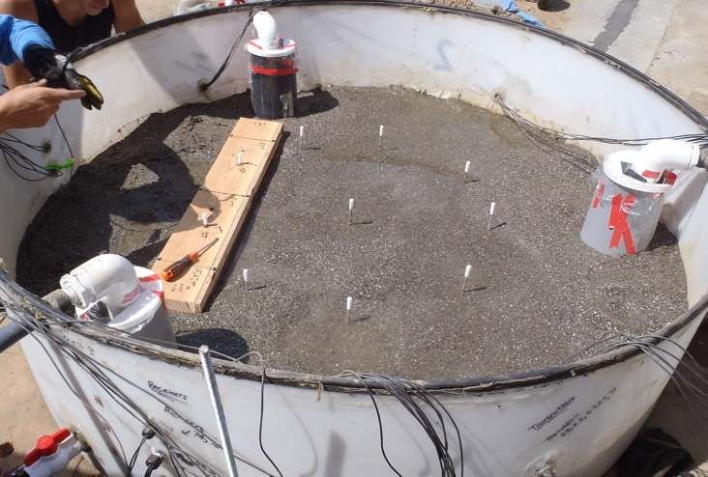
Meter-scale Experiment
1.7 m
(Injection Well)
Well 1
Observation Locations
0.3 m
Well 3
(Natural Sand with native microbes)
(production Well)
Well 2
14 Day Experiment
Cyclic well-to-well injections 1->2, 2->3, 3->1
Four phases: Passive tracer test, Stimulation of native ureolytic bacteria,
Cementation, Natural groundwater rinse.
13 Aqueous sample locations
(Urea, Ammonium and Ammonia, Bicarbonate and Carbonate, Calcium, & pH)
15 Calcite sample locations
Gomez et al., 2017 JGGE https://ascelibrary.org/doi/abs/10.1061/(ASCE)GT.1943-5606.0001640

Slide 11
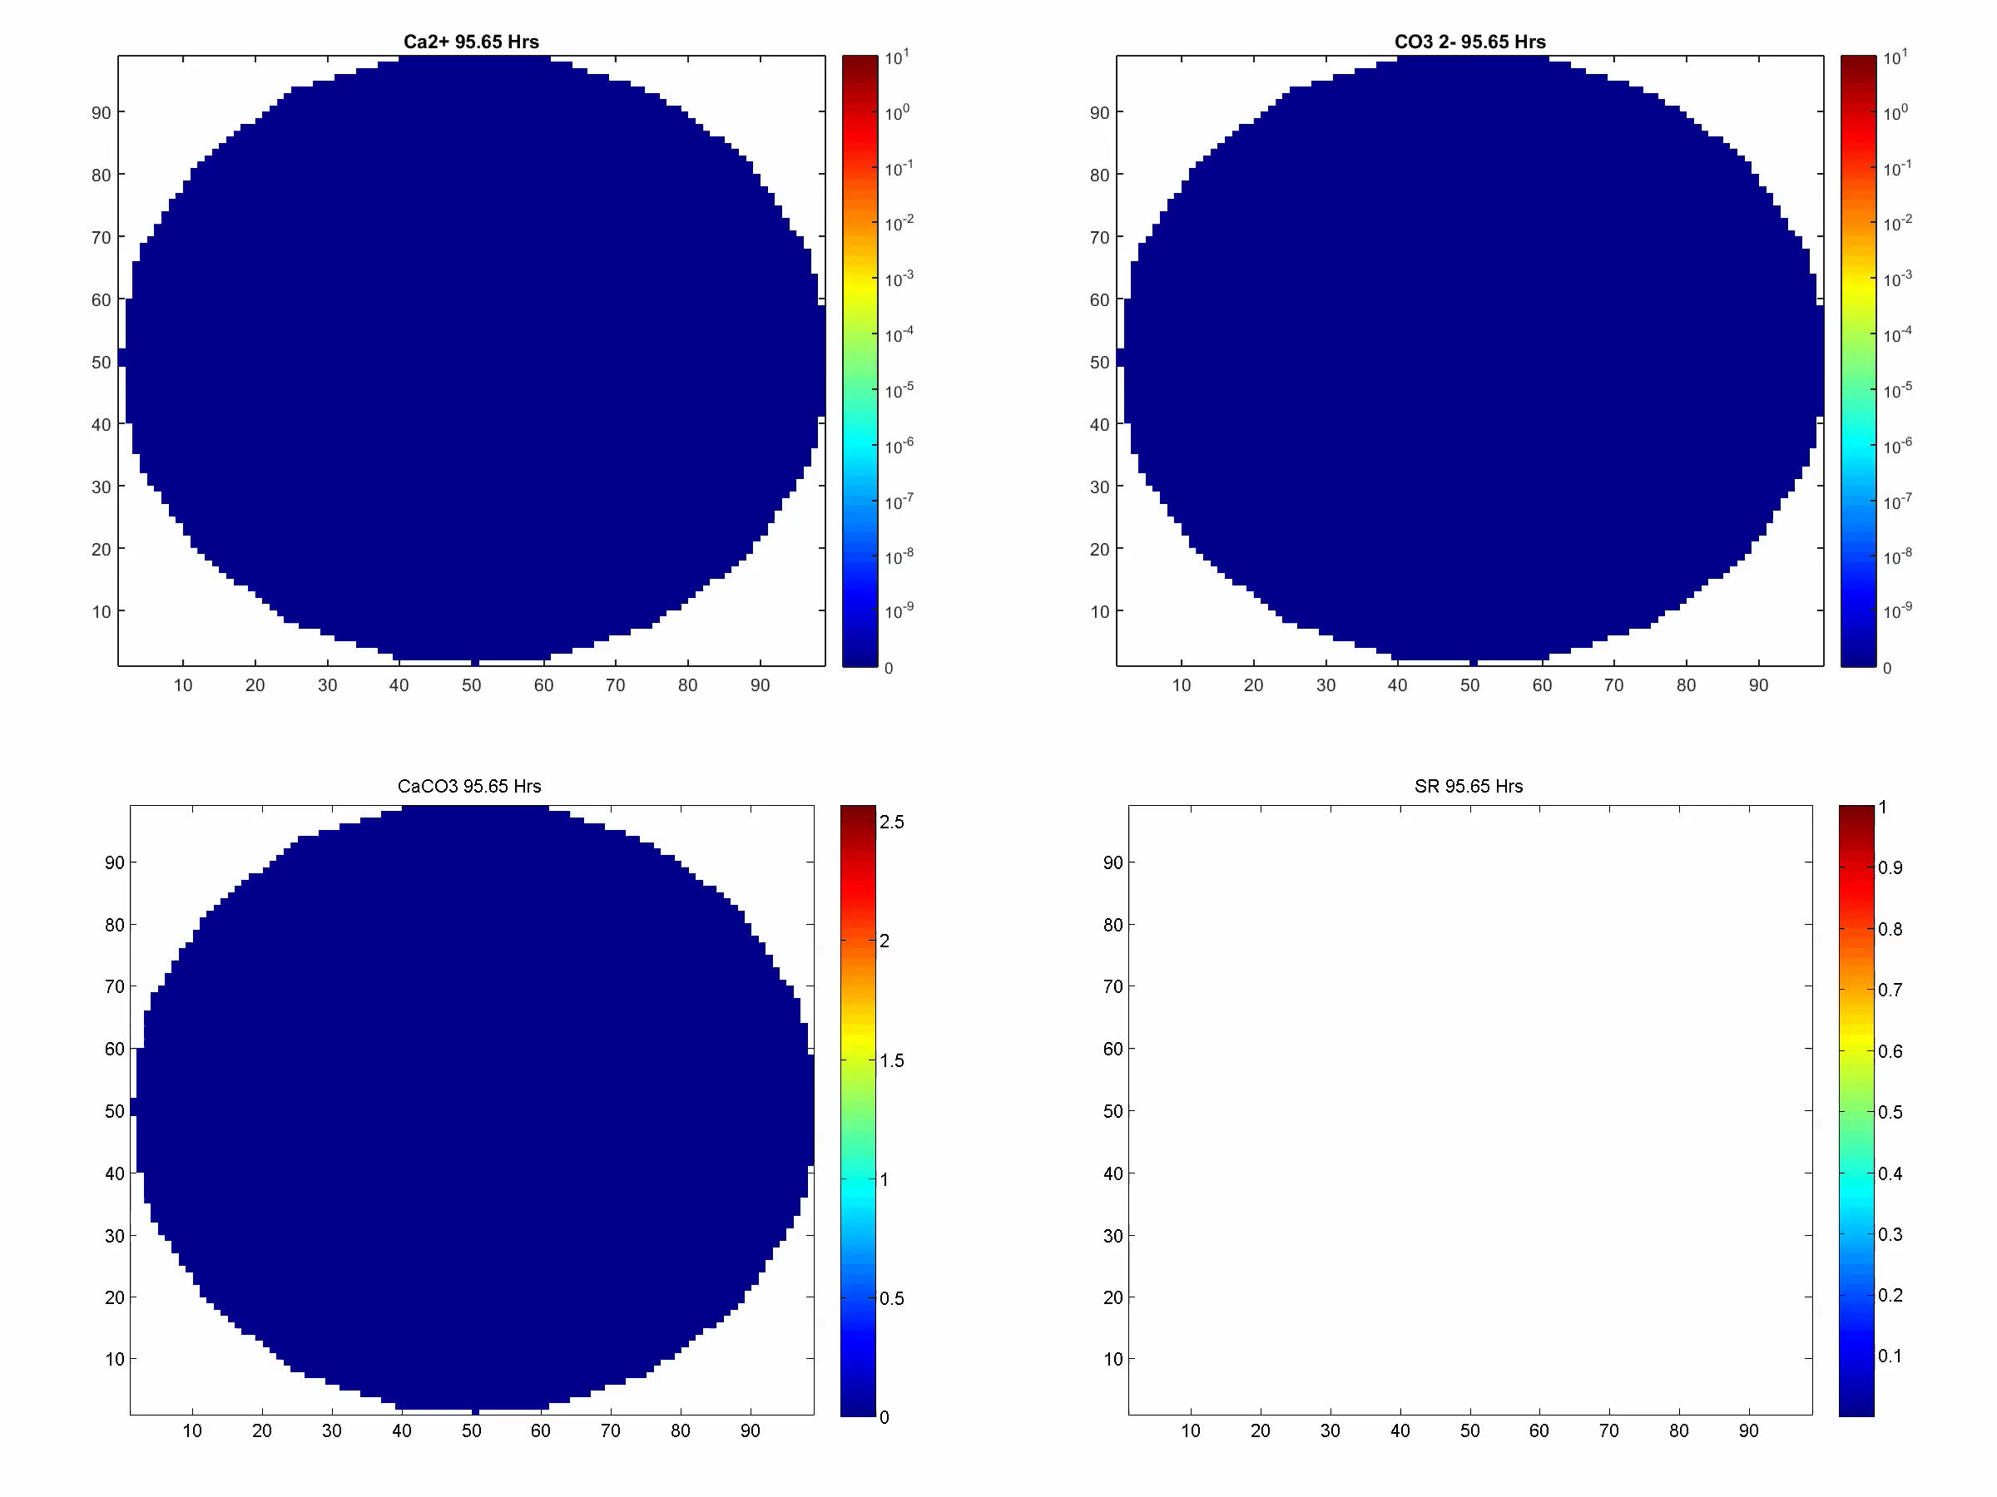

Slide 12
Differential Algebraic Equation (DAE) models of reactive transport impacted by mixing two examples: aerobic biodegradation, MICP Exposure time of mixtures three examples: solution to solid = groundwater age solute to some solid = chemical heterogeneity solute to its own gradient = scalar dissipation
Miscimetry in Reactive Transport

Slide 13
Mixture mechanics
• augment space coordinates with ω
• bulk densities of component α
• mixture mechanics mass conservation as
usual
• Volume Averaging (physical dimensions)
• Continuity equation
for each α component
of mixture
(v barycentric):

Slide 14
Mixture mechanics with exposure time
• augment space coordinates with ω
• bulk densities of component α
• mixture mechanics mass conservation
and proceed as usual
• Volume Averaging (physical dimensions)
• Continuity equation
for each α component
of mixture
(v barycentric):
A mathematical “clock”
Ginn WRR 1999 https://doi.org/10.1029/1999WR900013
Ginn WRR 2000a https://doi.org/10.1029/2000WR900170 and 2000b https://doi.org/10.1029/2000WR900171

Slide 15
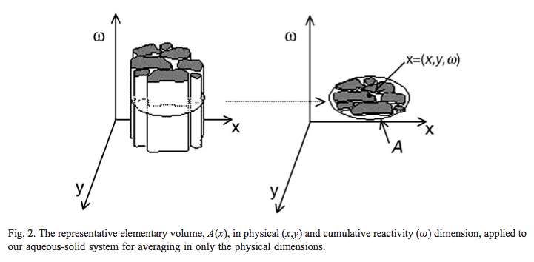
Support for volume averaging step
Seeboonruang & Ginn JCH 2005a https://doi.org/10.1016/j.jconhyd.2005.12.011

Slide 16
Exposure Time of to characterizes: solution to solid => groundwater age solute to some solid => chemical heterogeneity solute to its own gradient => scalar dissipation a proxy for reaction extent

Slide 17
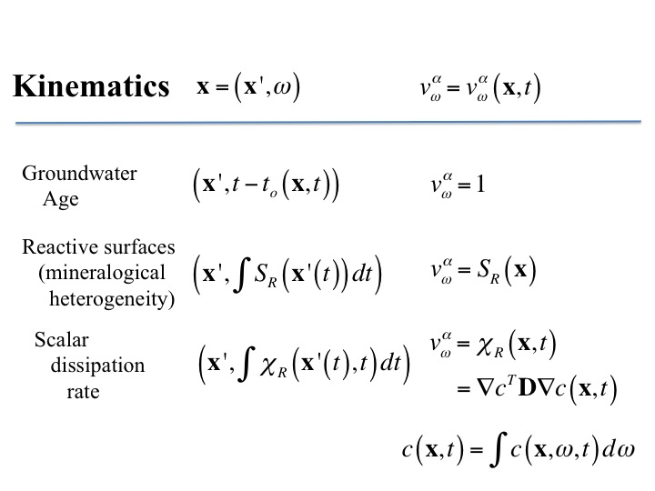

Slide 18
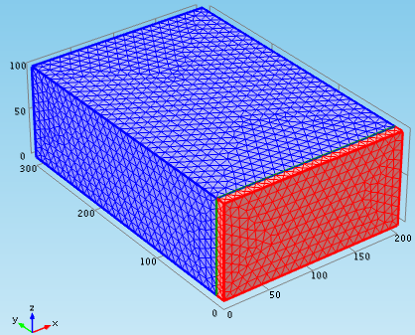
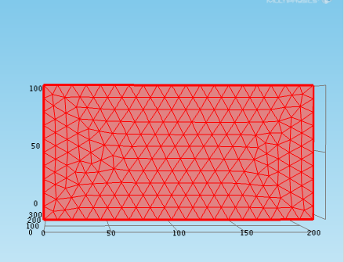
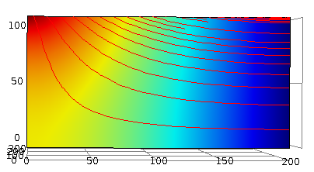
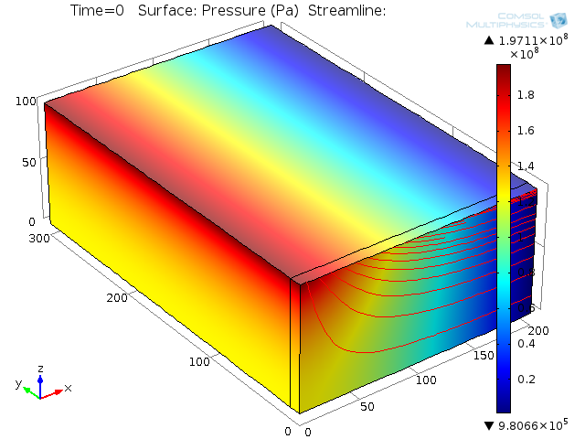
h(x,z=100)

Slide 19
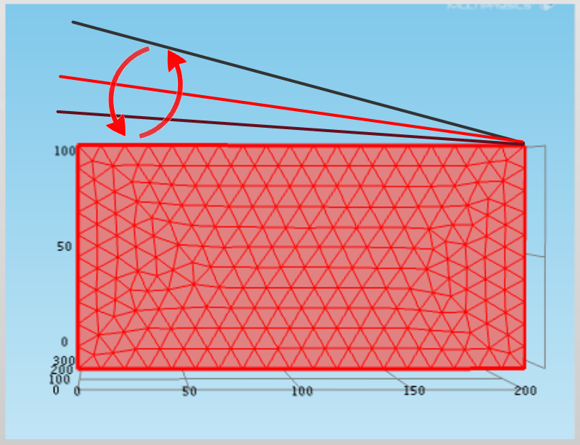
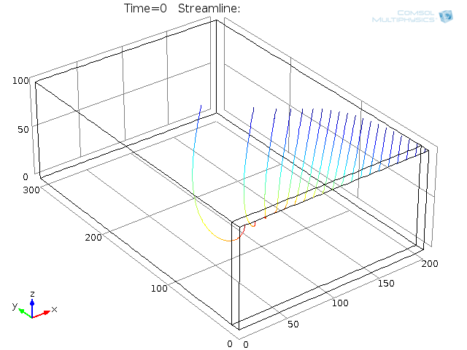

Slide 20
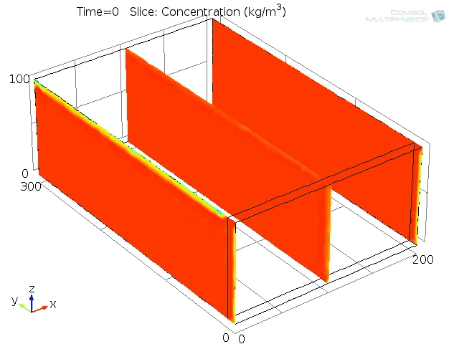

Slide 21
Mineralogical Heterogeneity

Slide 22
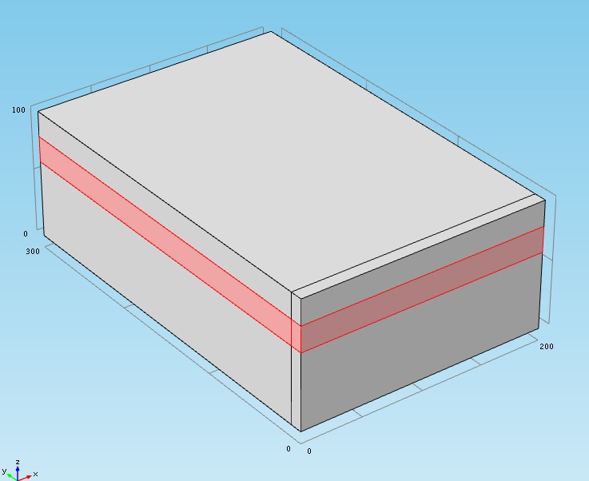
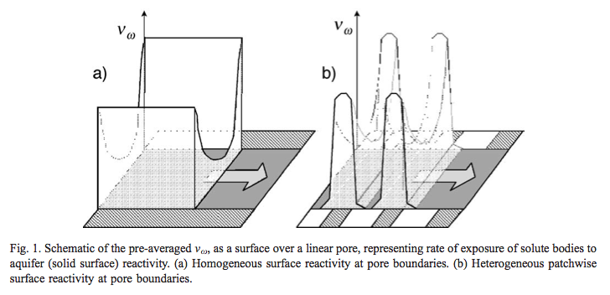
imagine a horizontal layer of reactive zone, in the original age problem, steady flow.
Starting point is pore scale
assignment of aging velocity.
This gives a dispersion when averaged. Not done yet, here only advection for simplicity.
Seeboonruang & Ginn 2005a,b https://doi.org/10.1016/j.jconhyd.2005.12.011, https://doi.org/10.1016/j.jconhyd.2005.12.010

Slide 23
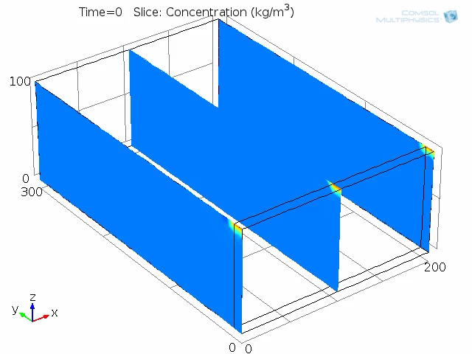

Slide 24
Solute Mixing

Slide 25
Scalar Dissipation Rate (Pope, 2000)
Dilution Index (Kitanidis, 1994 WRR)
It’s c/c_{o}...
Other candidates for integrand
Bimolecular reaction proxy
Localize this: Watch the integrand, not the integral

Slide 26
Scalar Dissipation Rate (Pope, 2000)
Dilution Index (Kitanidis, 1994 WRR)
It’s c/c_{o}...
Other candidates for integrand
Bimolecular reaction proxy
Localize this: Watch the integrand, not the integral
Use Exposure-time to keep track of a solute’s exposure to it’s own gradient

Slide 27
Advective-dispersive transport in a1D column

Slide 28
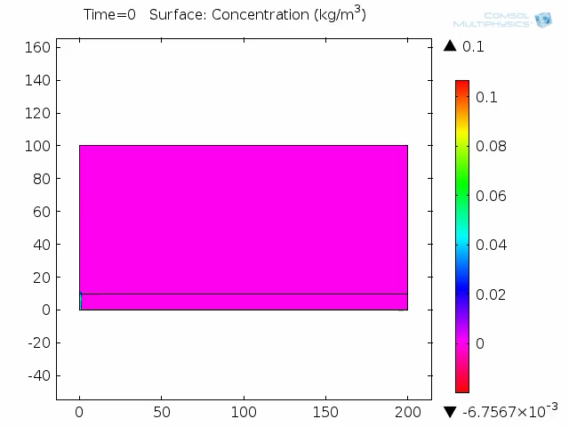
ω
x

Slide 29
Advective-dispersive transport in a 2D shear

Slide 30
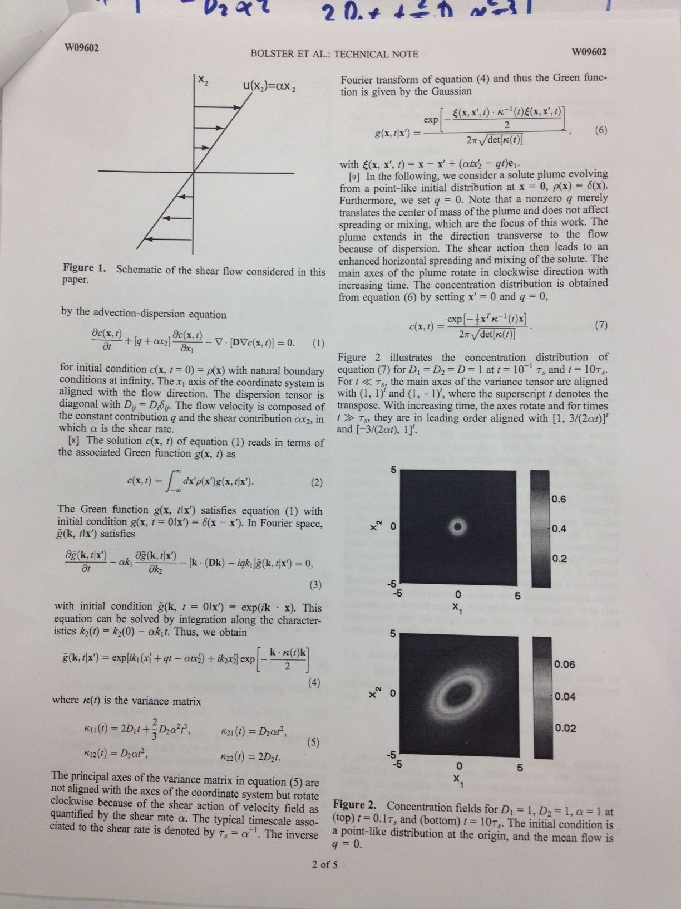
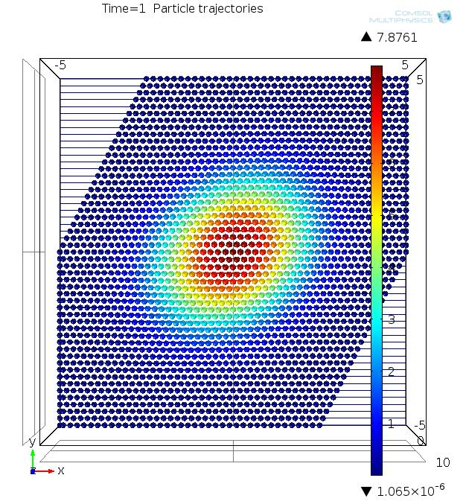

Slide 31
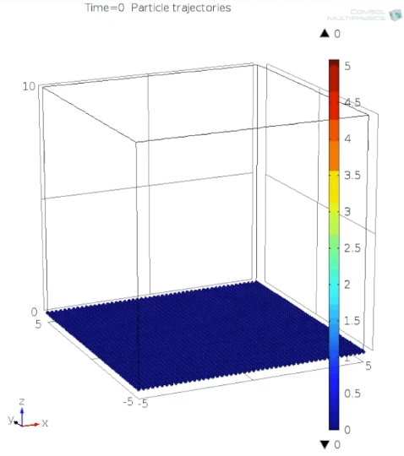

Slide 32
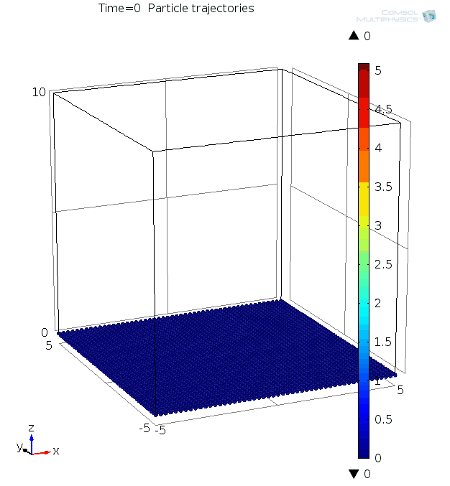
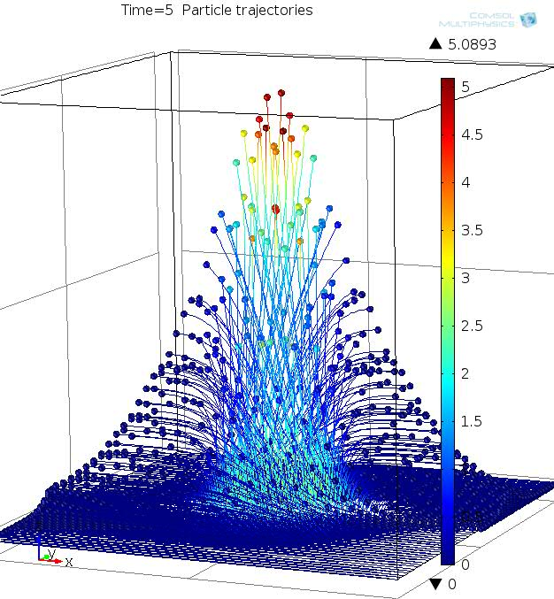


Slide 33
A new coordinate to measure extent of mixing
… extent of (effective) reaction
Upscaling Possibilities
Consistency with Transition State Theory ?
Two components linked by equilibrium reaction cannot age at different rates
Exposure time cannot depend on diffusive displacements

