Slide 1
CAHNRS Business Center
CAHNRS Internal Purchasing Training

Slide 2
I need to:
Request a Purchase within WSU:
  Interdepartmental Requisition and Invoice (IRI)
Request a Purchase outside of WSU:
  Request Non-Catalog Items
Pay an Invoice:
  Create Supplier Invoice Request
Create Supplier Request
Verify Procurement Card Transaction
Find Procurement Card Transaction

Slide 3
Interdepartmental Requisition and Invoice
(IRI)
Use this form to make purchases within WSU.
Step One: Fill out IRI Form. (see next page for example)
  Form available:
    https://business-center.cw.wsu.edu/purchasing/
    https://policies.wsu.edu/prf/04-01-forms-index/
Step Two: Submit IRI for approval.
  Submit to:
    Project/Program/Gift approval: purchasing.bc@wsu.edu
    Grant approval: Department Grant Administrator
Step Three: Email IRI to Supplier Department.

Slide 4
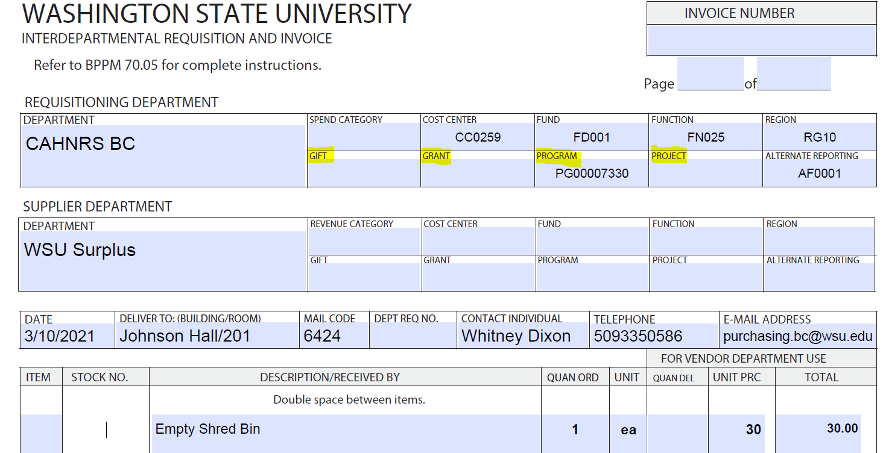
IRI Example
Enter appropriate Gift/Grant/Program/Project

Slide 5
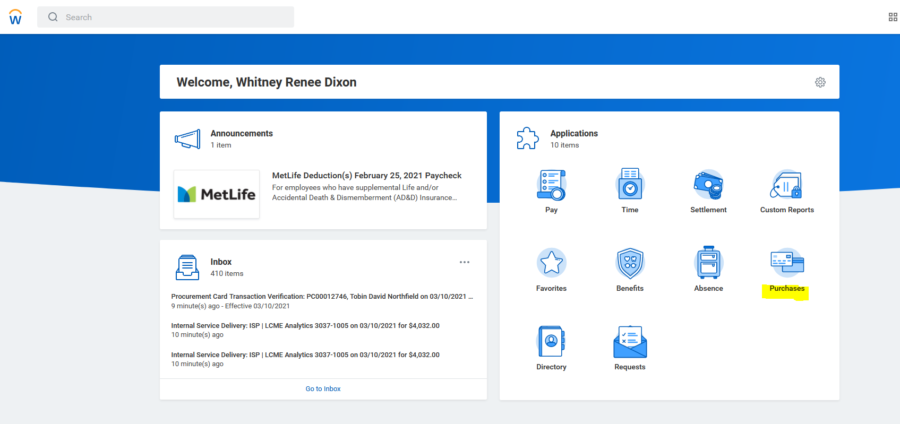
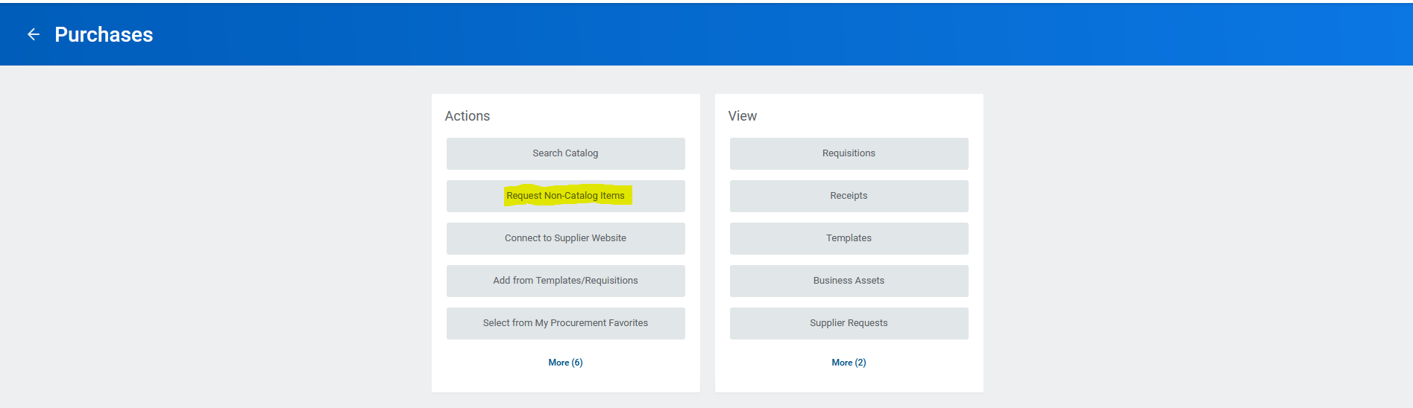
Request Non-Catalog Items
Request Goods
Request Service

Slide 6
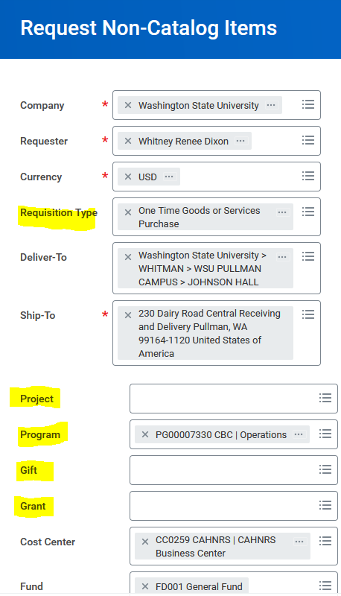
Request Non-Catalog Item
See next slide for Requisition Type
Step 1:
Choose Requisition Type & Funding
Choose appropriate Project/Program/Gift/
Grant worktag.
Cost Center, Fund, Function, Region, and
Additional Worktags should auto-fill.

Slide 7
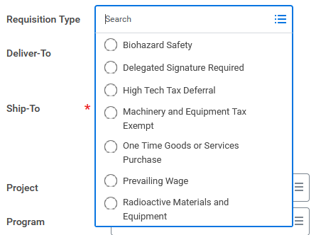
Requisition Type
Choose the appropriate type of requisition based on items being requested.
Most common:
  Machinery and Equipment Tax Exempt
  One Time Goods or Services Purchase
  Prevailing Wage

Slide 8
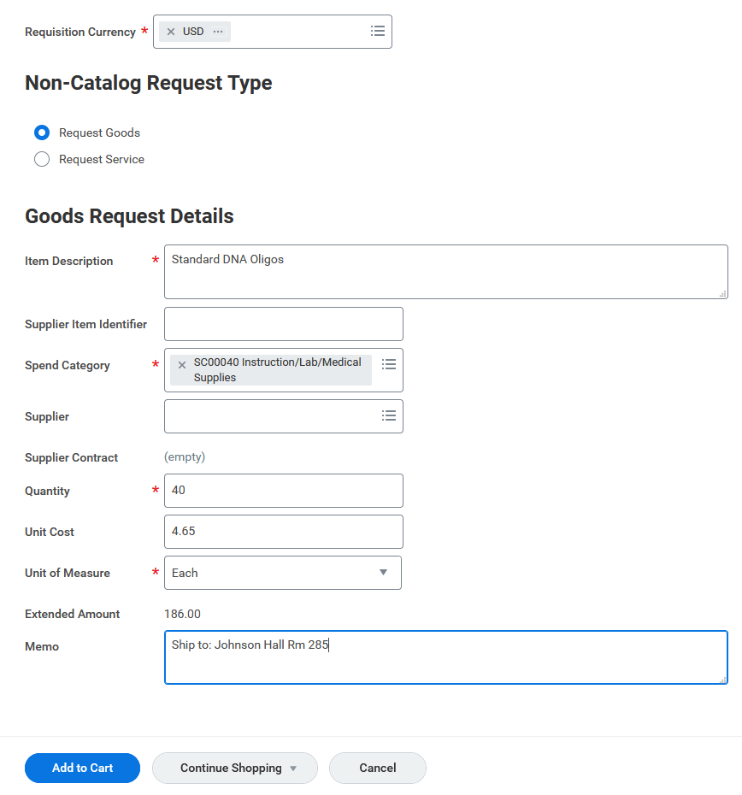
Searchable Field, common spend categories:
SC00038 Office Supplies
SC00040 Instruction/Lab/Medical Supplies
SC00041 Supplies and Materials
SC00042 Agricultural/Grounds Maint Supplies
SC00118 Other Routine Contractual Services
  Laboratory Analysis Services
  Other Purchase Services
Special Note: If equipment is over $5K a Capitalized Equipment Spend Category needs to be used.
Information needed to process an order:
Shipping information
Add to Cart.

Slide 9
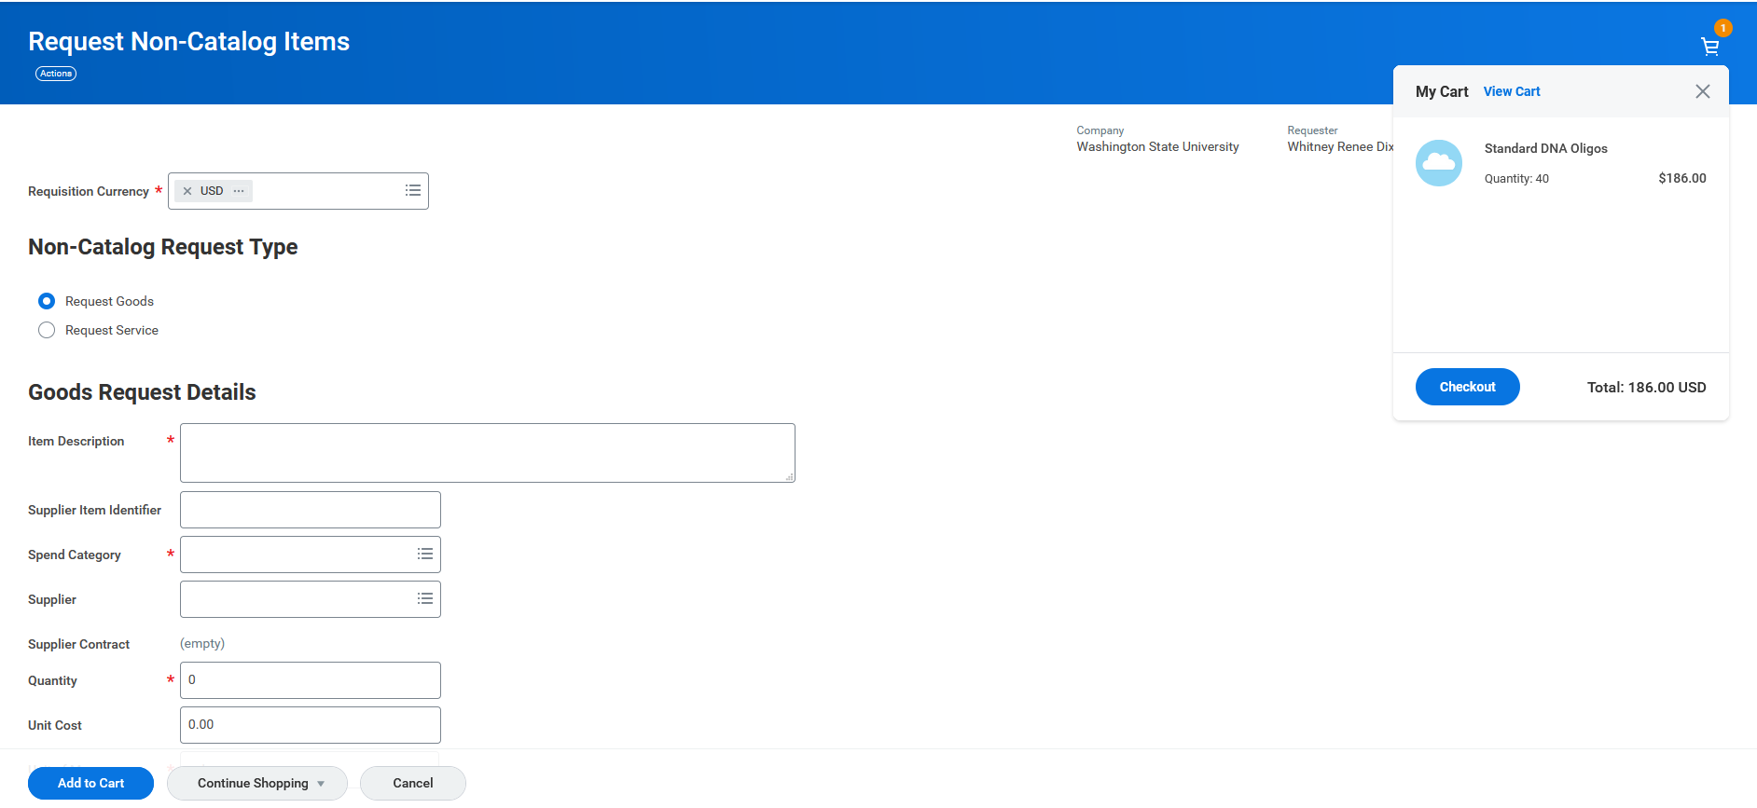
When ready to “Checkout”.
Click on the cart and then Checkout.
Special Note: If additional items need added continue adding to cart. (One request per vendor.)

Slide 10
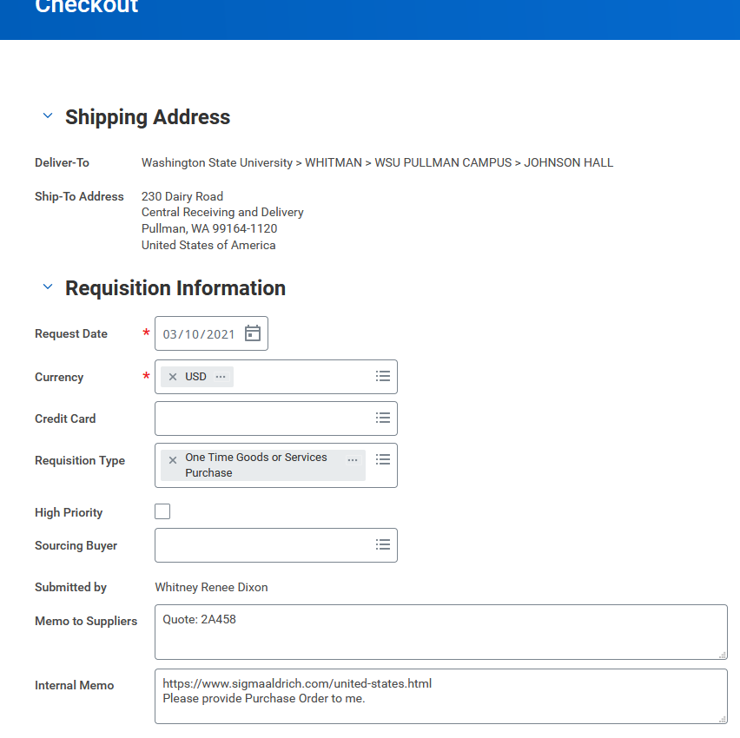
For Purchase Order requests:
Quote Number if applicable
Specific shipping instructions
Add Comments to ease purchase process
URL
Specific Instructions
Vendor name (If vendor is not in system a W9/W8BEN will need to be attached or company will need to accept pcard payments)

Slide 11
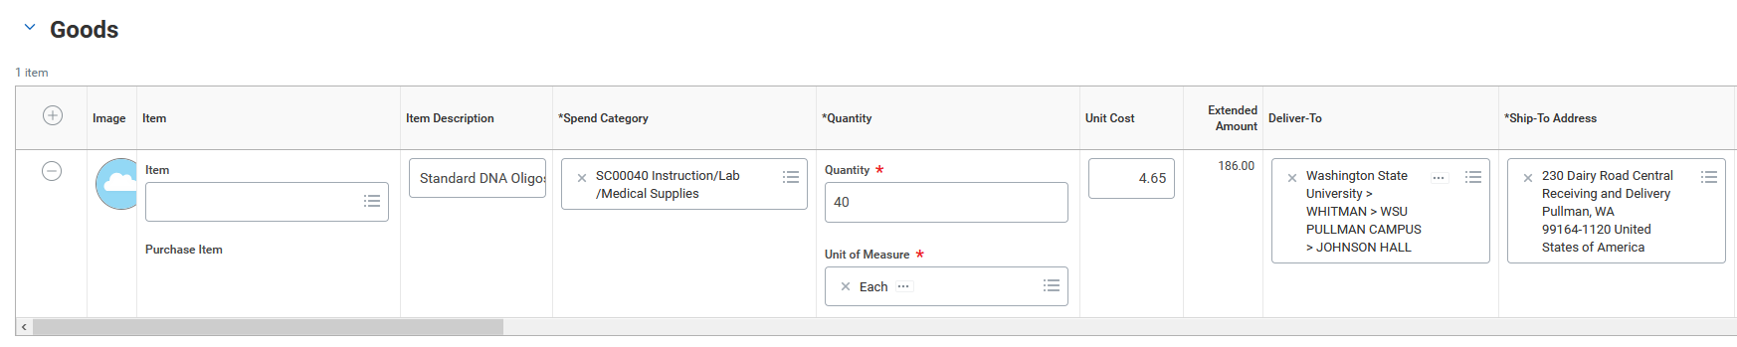
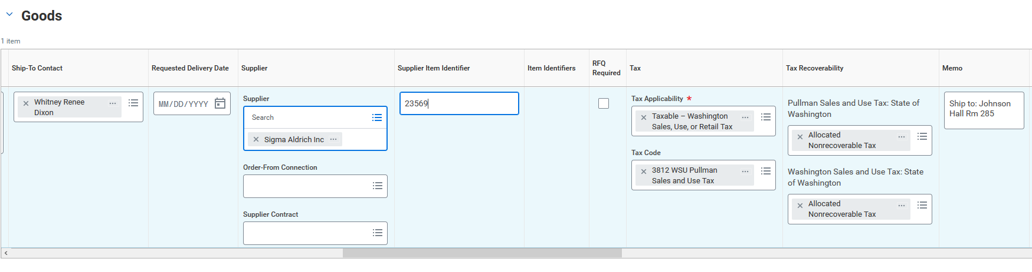
Most of the items in the goods line will auto-fill
Deliver-To:
Select your building from the drop-down options
If the Supplier is not selectable, the supplier must accept a pcard payment or a W9/W8-BEN will be required to move forward with purchase.
If purchase type is Machinery and Equipment Tax Exempt, make sure to select M&E Tax Exempt.
Catalog, ASIN, Merchant, etc. Number used by supplier to identify the item.
Tax Code is based on the destination of the goods

Slide 12
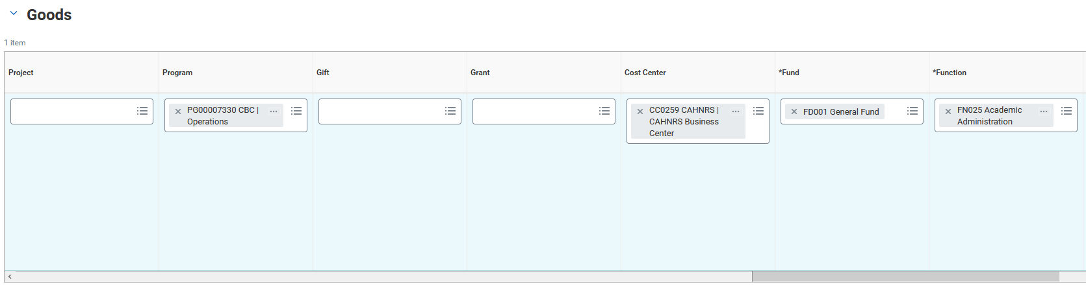
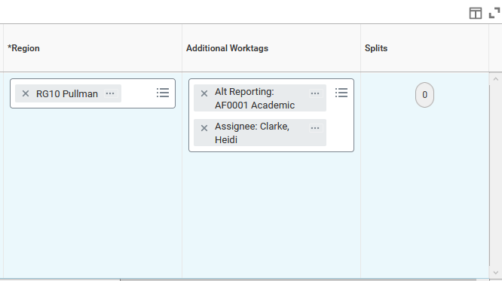
Most of the items in the goods line will auto-fill
See Next screen for split instructions

Slide 13
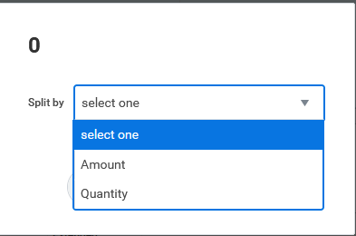
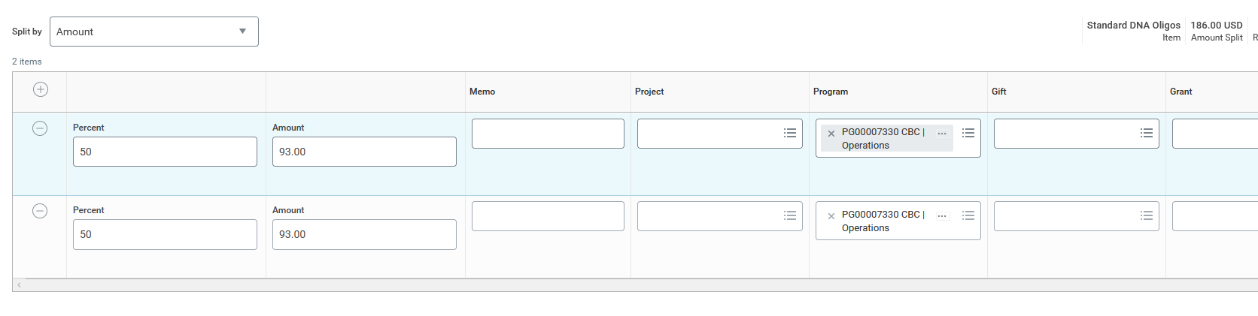
Split Funding on request, must be done on each line item.
Select One
Update funding: Project/Program/Gift/Grant

Slide 14
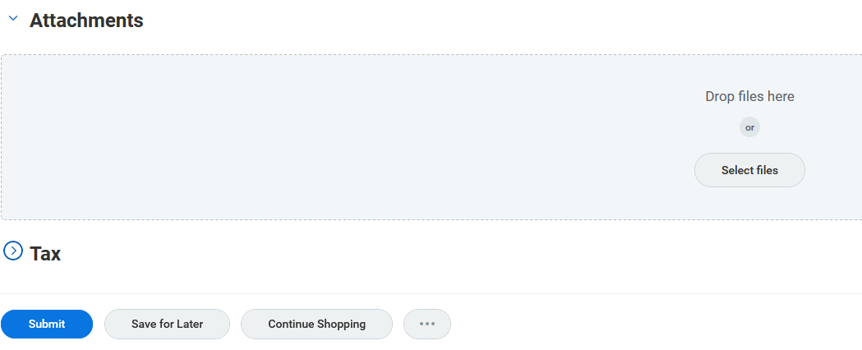
Attach documents here: (any applicable)
Quote
Bids
Sole Source
Freeze Exempt
Executed Contract
Special Note: If you are completing a request for Machinery and Equipment Tax Exempt a questionnaire will be available once you submit. This takes the place of the previously required Tax-Exempt Request Form.
When Ready

Slide 15
Create Supplier Invoice Request
Invoice in hand needing paid

Slide 16
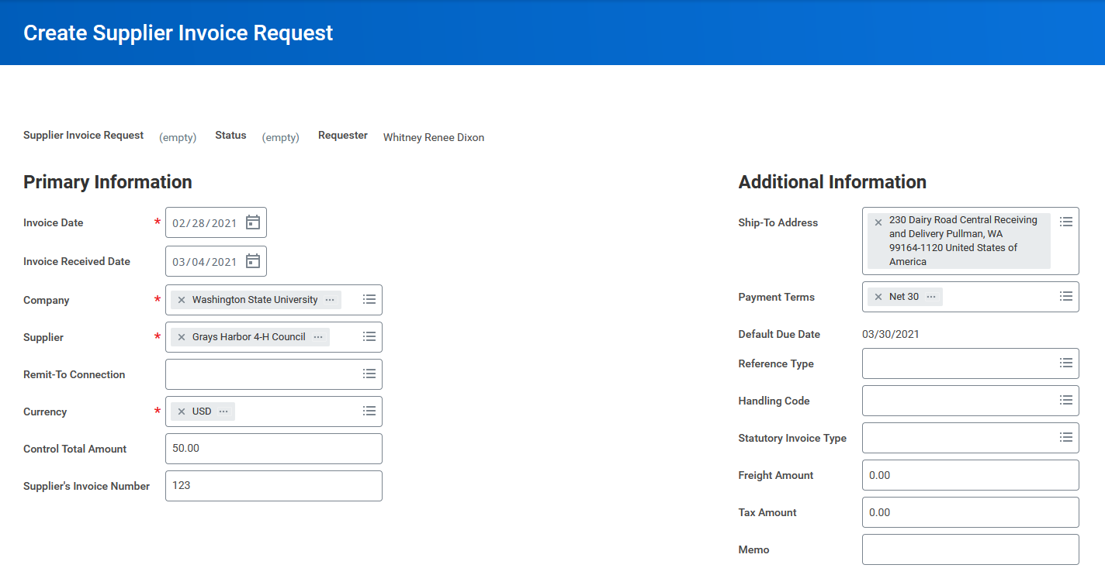
Date on Invoice
Date you received invoice
If supplier is not selectable a W9/W8BEN will need to be submitted before invoice can be submitted.
Do not use.
Needs to match invoice exactly to prevent duplicate payments.
Reference:
Contract or PO if applicable

Slide 17
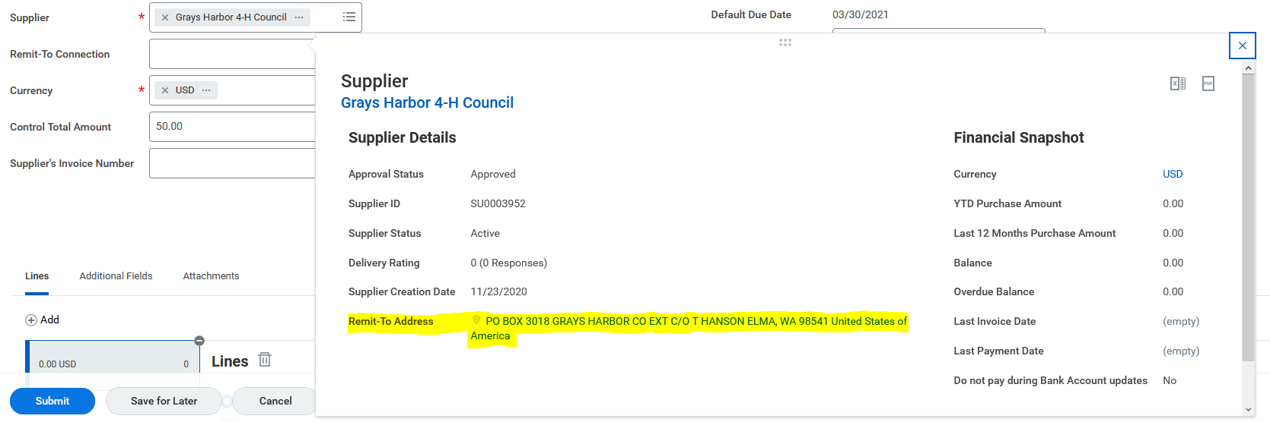
Tip: Verify the Remit to Address matches the address on your invoice

Slide 18
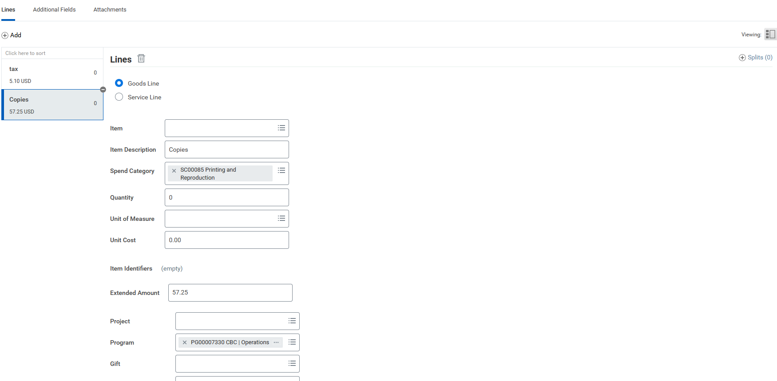
Upload Copy of the invoice.
Add line item for each spend category.
See next slide
Select to split funding by Quantity or Amount
Searchable Field
Select appropriate Project/Program/Gift/Grant

Slide 19
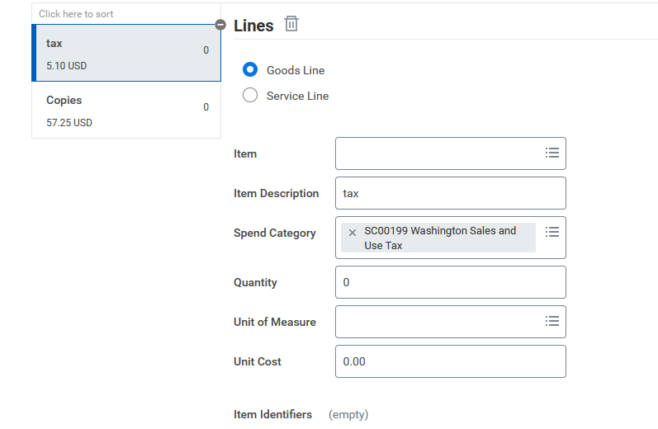
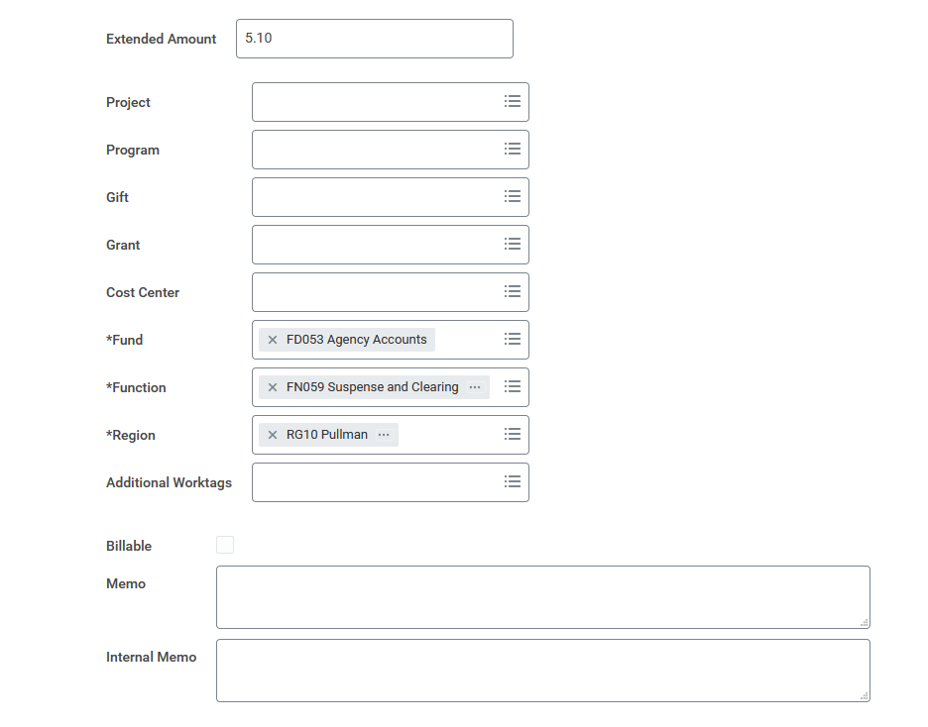

Tax Line
Spend Category SC00199
Remove All:
Project/Program/Gift/Grant
Cost Center
Additional Worktags
Add any additional Memos that may help with approval/payment process.
Submit when done.
Special Note: If tax is not on the invoice do not add this line.

Slide 20
Create Supplier Request
If Supplier is not in WSU System obtain a W9 or W8BEN
  Enter into Workday
  or
  Contact Business Center (purchasing.bc@wsu.edu)

Slide 21
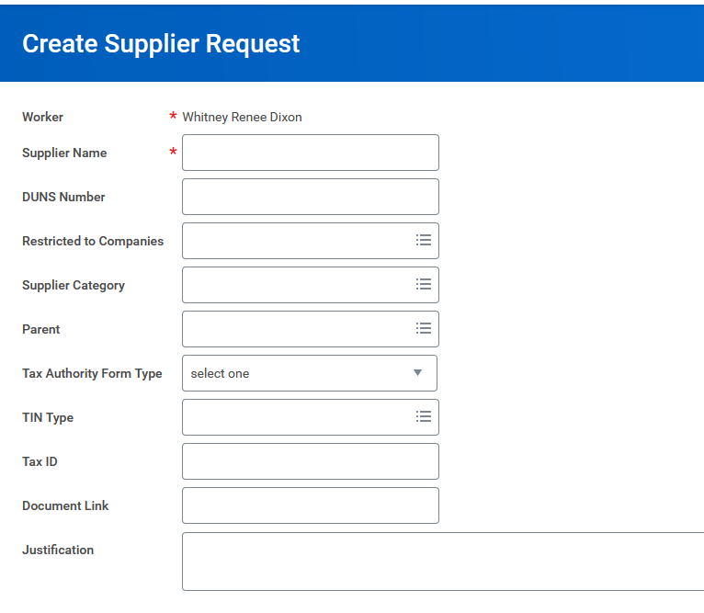
Fill in information based on what is on W9/W8BEN
Option marked on W9
Enter or Select based on
what is provided on W9

Slide 22
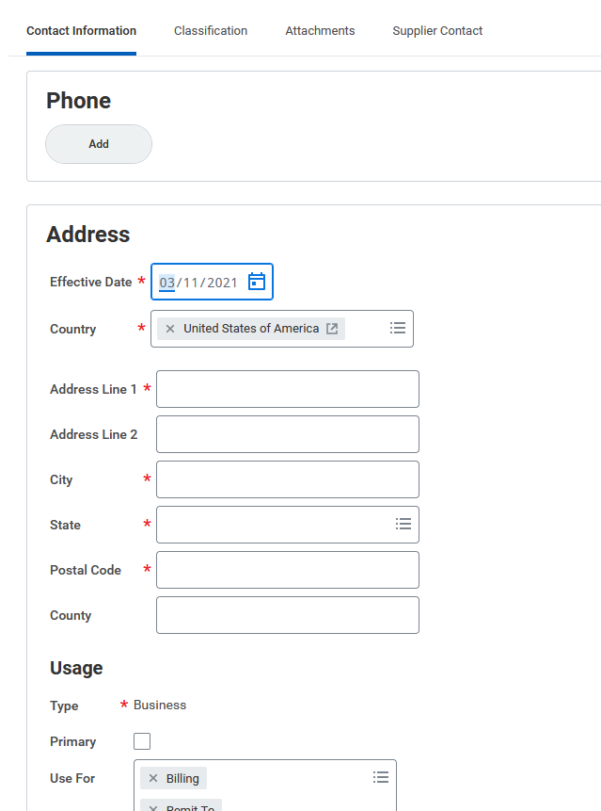
Add W9
Option marked on W9
Enter or Select based on
what is provided on W9
One Address must be marked Primary
Fill in information based on what is on W9/W8BEN

Slide 23
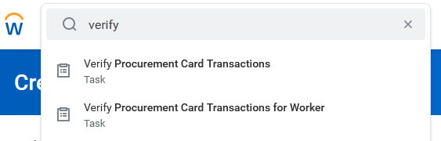
Verify Procurement Card Transactions
Verify for Worker when you are not the cardholder

Slide 24
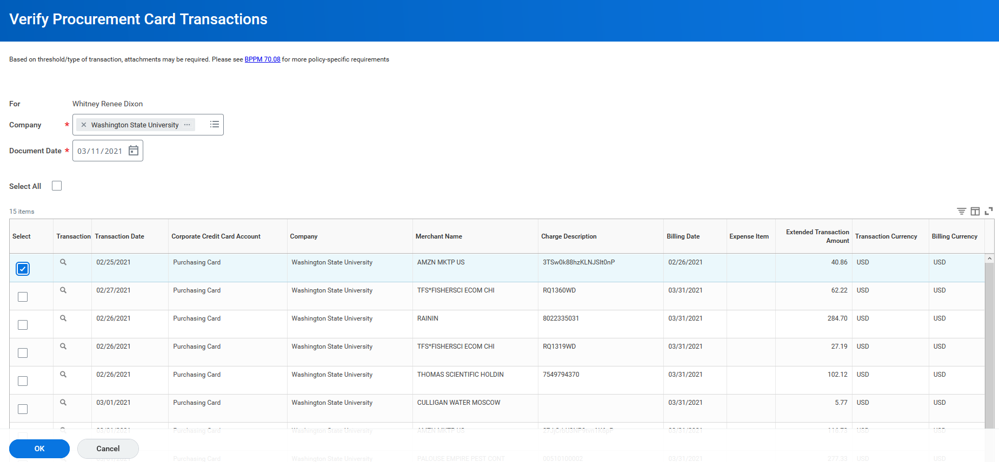
Select 1 transaction at a time

Slide 25
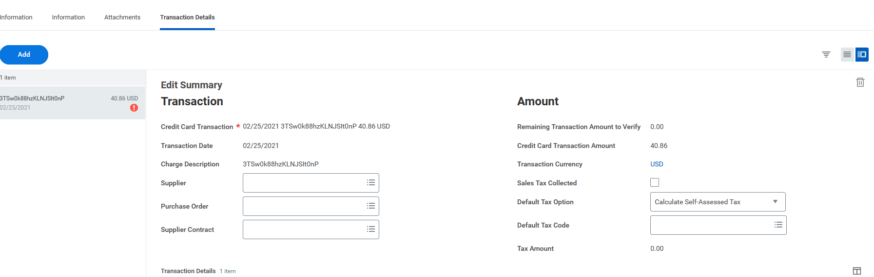
Try to enter the supplier. If the correct supplier does not come up leave blank.
Do not select
Not Required
Based on destination of Goods/Services, if selected here will auto-fill in Transaction details below.
This amount may differ from what is on your receipt

Slide 26
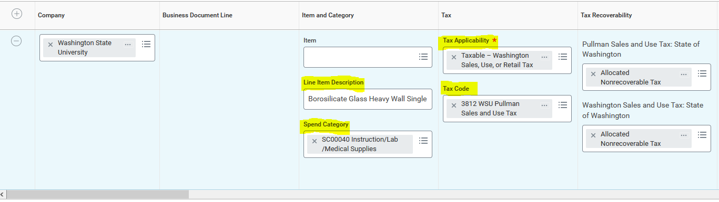
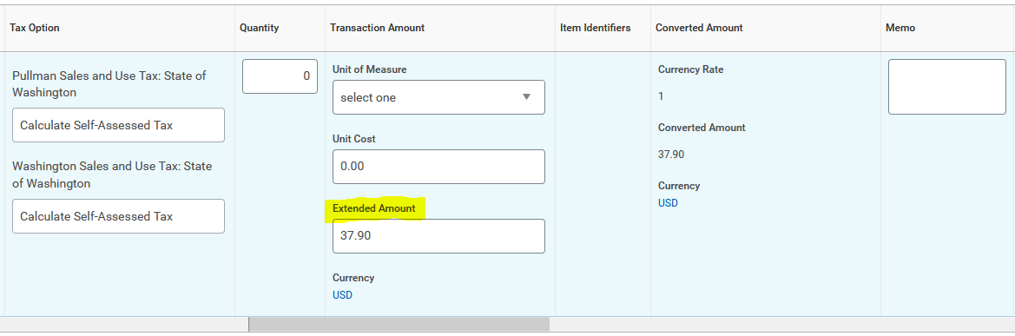
Transaction Details – Goods/Services – Highlighted fields should be filled in
Tax Applicability can be changed if necessary
Searchable Field
These auto-fill
optional
Amount not including tax, if tax is on your receipt

Slide 27
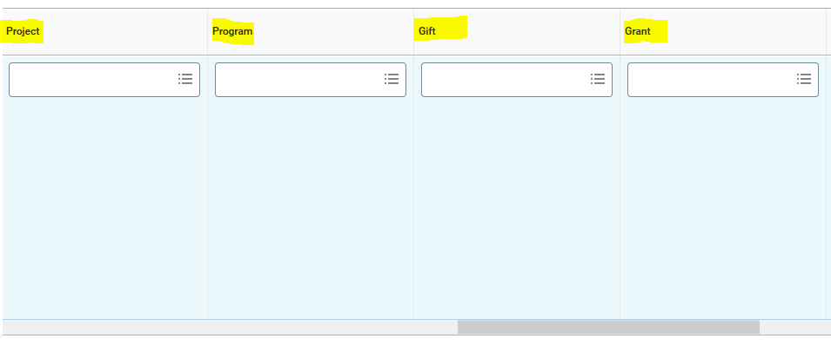
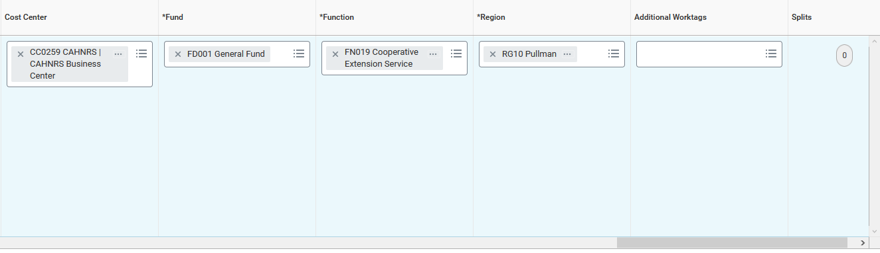
Transaction Details – Goods/Services – Highlighted fields should be filled in
Input appropriate account Worktag – should be one of the four.
To split Funding
Cost Center, Fund, Function, Region and Additional Worktags should auto-fill

Slide 28
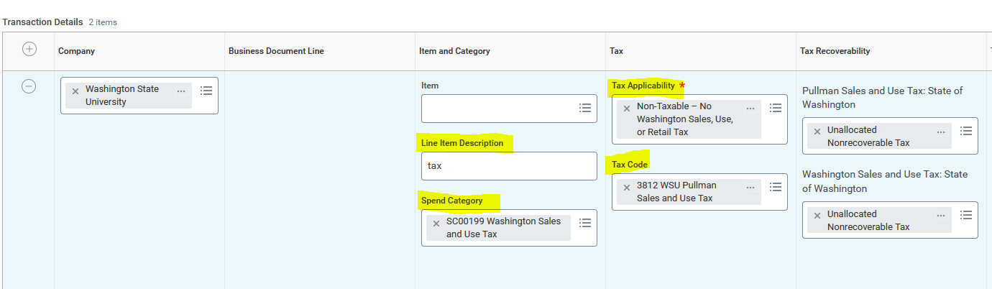
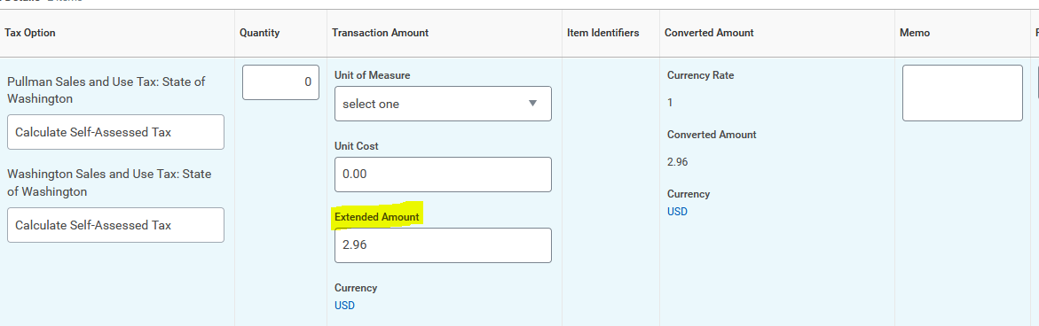
Transaction Details – Tax – Highlighted fields should be filled in
Spend Category for tax
SC00199
Special Note: If your receipt does not show tax this line should NOT be added.
Amount on receipt

Slide 29
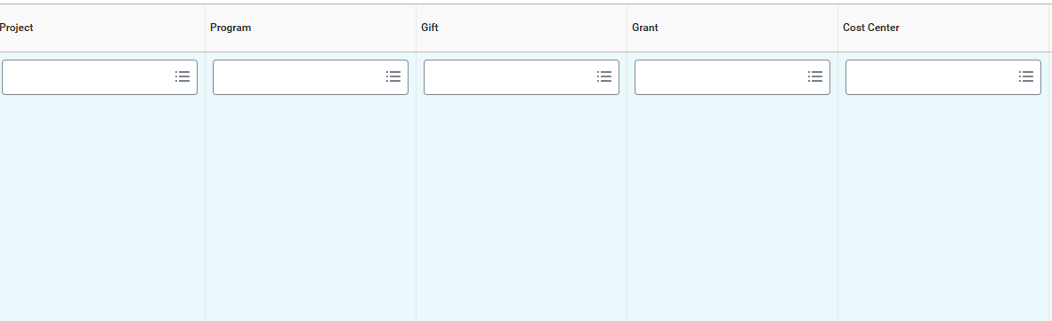
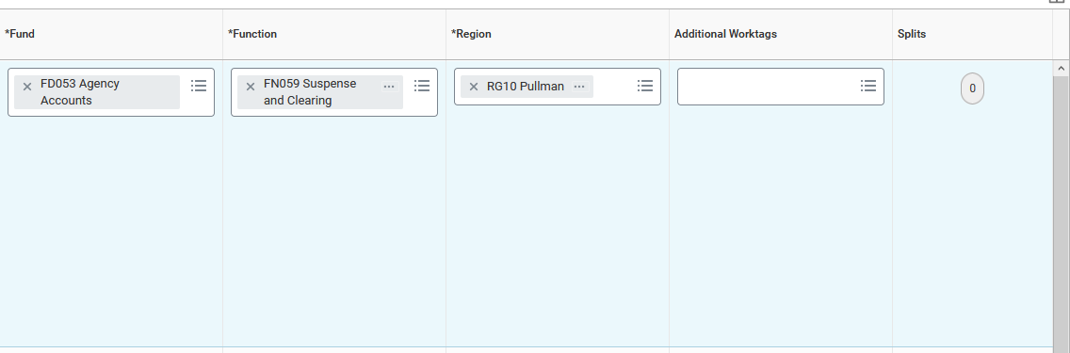
Project, Program, Gift, Grant and Cost Center need to be blank
Fund: FD053, Function: FN059 and Region: RG10
No Additional Worktags
Do not split funding on tax line

Slide 30
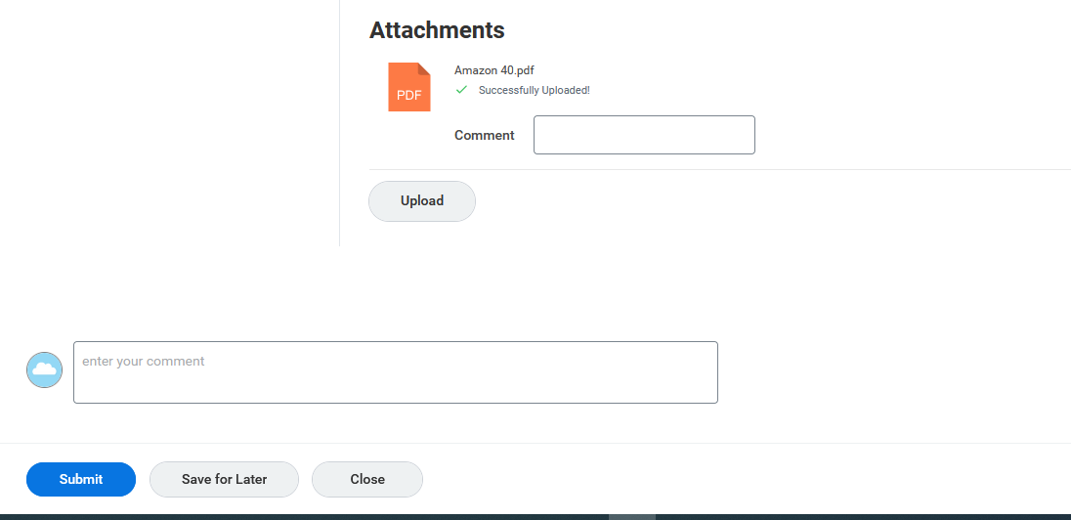
Upload PDF version of your invoice and/or Receipt
Once complete Submit

Slide 31
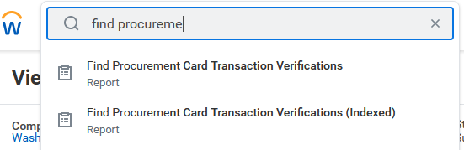
Find Procurement Card Transaction Verifications
Reports are the same, select one to continue

Slide 32
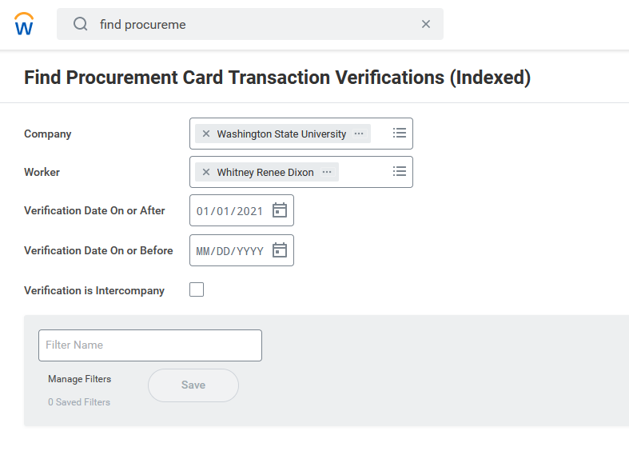
Can be left blank

Slide 33
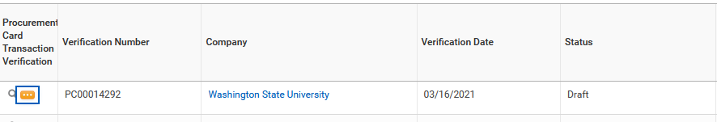
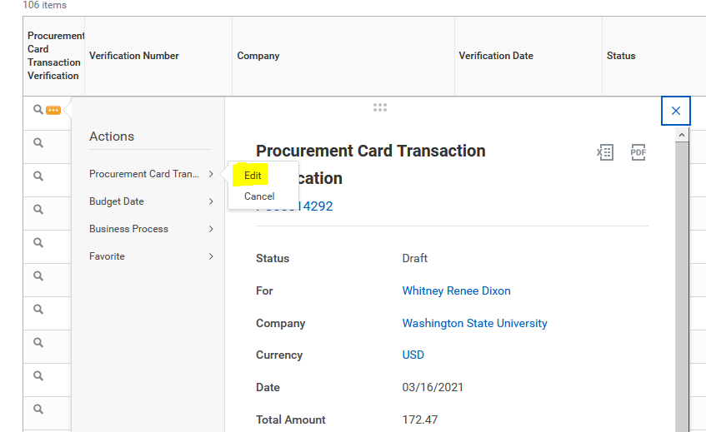
Transactions in draft status have not been submitted/approved.
To edit or complete:
Step 1
Step 2
Step 3

Slide 34
References
Business Center Purchasing
  https://business-center.cw.wsu.edu/purchasing/
Workday Reference Guides
  https://confluence.esg.wsu.edu/display/WKB/Reference+Guides
Budget-Project Crosswalk
  https://wsuaacprodoac-wsucloud.analytics.ocp.oraclecloud.com/analytics/saw.dll?Dashboard&PortalPath=%2Fshared%2FWSU%20Modernization%20Crosswalks%2F_portal%2FWSU%20Modernization%20Crosswalks%20-%20Finance&page=XW_ACCOUNTS
Request Non-Catalog Item
  https://confluence.esg.wsu.edu/display/WKB/Create+Requisition
Create Supplier Invoice Request
  https://confluence.esg.wsu.edu/display/WKB/Create+Supplier+Invoice+Request
Create Supplier Request
  https://confluence.esg.wsu.edu/display/WKB/Create+Supplier+Request
Procurement Card Transaction Verification
  https://confluence.esg.wsu.edu/display/WKB/Procurement+Card+Transaction+Verification
Always feel welcome to reach out to purchasing.bc@wsu.edu for additional information or guidance.
Thank you.

