Slide 1

Recognizing and Responding to Microaggressions
presented by Obie Ford III, PhD
Campus Director of Equity and Diversity
Washington State University Vancouver
Reimagining the First Year Professional Development

Slide 2
Microaggressions and Mosquito Bites
https://youtu.be/hDd3bzA7450

Slide 3
What are Microaggressions?
What do you know about microaggressions
“Brief and commonplace daily verbal, behavioral (nonverbal), and/or environmental indignities whether intentional or unintentional, that communicate hostile, derogatory, or negative racial slights and insults toward people of underrepresented communities and/or or people perceived to hold less power.” (Pierce, 1970; Sue 2010)

Slide 4
Types of Microaggressions
Microassault
  Explicit derogations characterized primarily by a violent verbal, nonverbal, or environmental attack to hurt the intended target through name-calling, avoidant behavior, or purposeful discriminatory actions.
Microinsults
  Communications that convey rudeness and insensitivity and demean a person’s identity
Microinvalidation
  Communications that exclude, negate, or nullify the psychological thought, feelings, or experiential realities of people who experience micro-aggressions

Slide 5
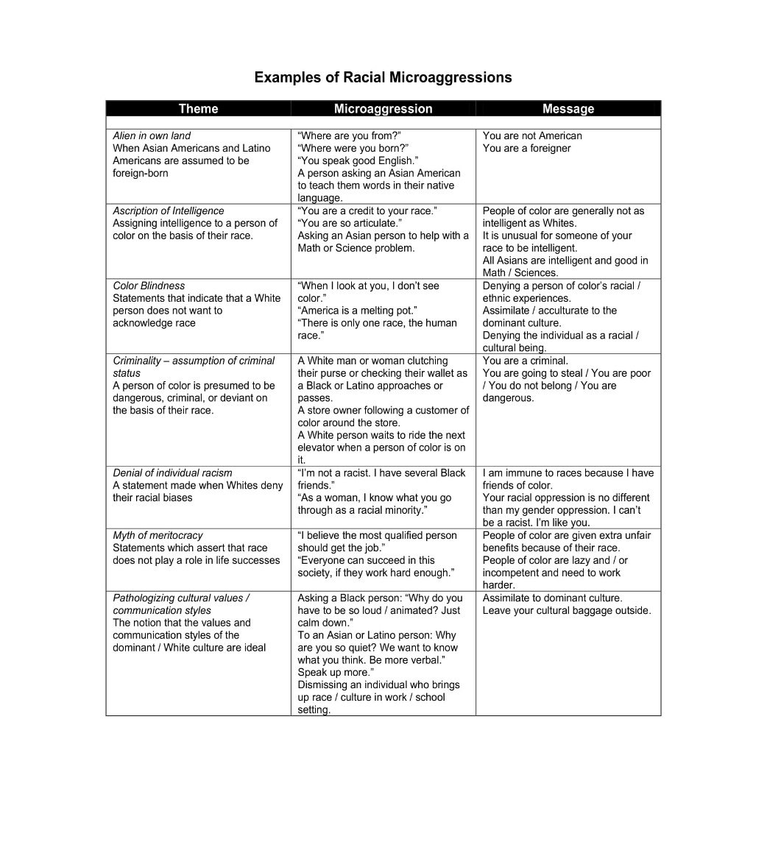
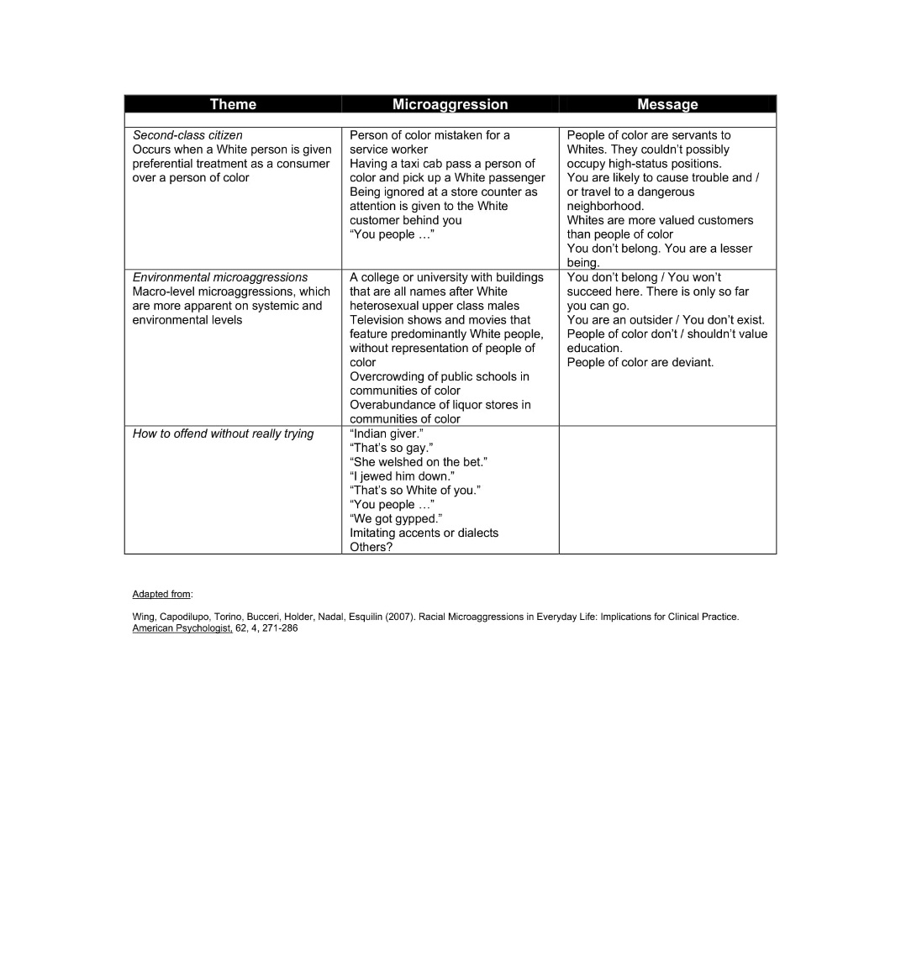
Examples of Microaggressions

Slide 6
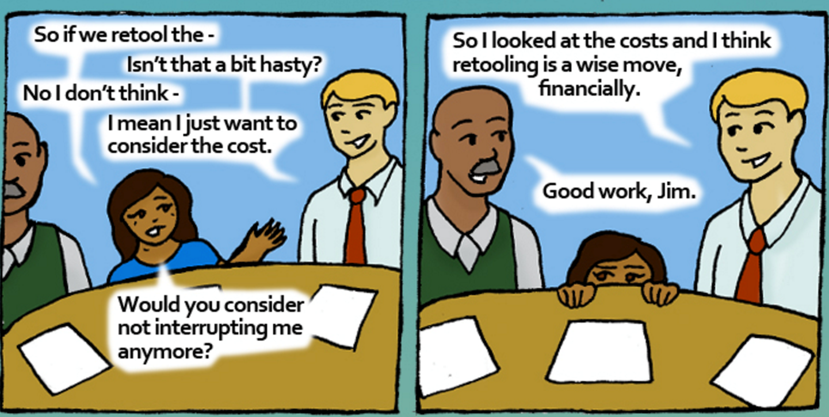
Microaggressions: What is your experience?

Slide 7
Macroaggressions
Macroaggressions
The structural and systemic arrangements that validate the interests/positions of a dominant group over non-dominant groups. This structure provides a foundation that justifies institutional oppression – from which microaggressions are able to persist. (Huber & Solorzano, 2015)

Slide 8
Microaggressions in the Classroom
Short film featuring students and faculty at University of North Texas
https://vimeo.com/204588115

Slide 9
The Impact of Microaggressions
Reinforces and perpetuates oppression, including marginalization
Three-part decision-making model (Nadal 2010)
  Did this microaggression really occur?
  Should I respond to this microaggression?
  How should I respond to this microaggression?
Choose NOT to confront: feel regret, remorse, isolation, guilt, and/or shame
Choose to confront, may feel fear:
  of appearing like a negative representation of their social group (i.e., race)
  of retaliation from the person(s) confronted (i.e., student may fear professor retaliation);
  that they chose an ineffective method of communication

Slide 10
The Impact of Microaggressions
Hurts and re-traumatizes people who already experience oppression in the larger world. This can significantly affect one’s ability to be present and learn as they are consumed by their need to take care of their emotions.
Feelings of pain can accumulate and affect student overall health and well-being and possibly retention.
Erodes any trust & credibility established with the professor/staff/student leader and seen as someone who “doesn’t care about people like me.”
By not “leaning into” and examining the situation, we miss learning opportunities for everyone involved.

Slide 11
Responding to Microaggressions
As campus educators and student leaders, what we can do: Facilitate the process, not the content.
Do not allow a charged statement to be brewed over in silence:
With a clearly annoyed tone, a white student says to professor: “This is UNIV 104, not a course on diversity!” Model what you want students to do by acknowledging the statement:
Professor/Student Leader: “It sounds like you’re making a distinction between diversity and UNIV 104, that talking about diversity, equity, and belonging are not valid topics for this course. Is that what you are saying?”
Student: “No, that’s not what I’m saying!”
Professor/Student Leader: “Okay, please clarify what you are trying to say?”

Slide 12
Responding to Microaggressions
As campus educators and student leaders, what we can do: Lean into the tension.
Acknowledge necessity of having conversations. Prepare the class for transitions: entering, moving through, continuing/concluding/exiting the conversation.
“We may be entering crucial and important terrain here. As a class, how can we make sure that each person is heard?” Revisit grounding assumptions and needs during class discussions – allow this to evolve per discussion.
Keep an open mind by asking questions that help you better understand what the person is trying to communicate.
Avoid being defensive by making grand statements about ourselves or others.

Slide 13
Responding to Microaggressions
As campus educators and student leaders, what we can do: express appreciation.
It’s important to recognize, validate, and express appreciation to students for their bravery, openness, and willingness to participating in deliberate dialogue.
“As a class, we have just experienced crucial conversation. I appreciate your courage and commitment to your education by being willing to engage in these kinds of important and critical conversations. It’s not uncommon to walk away from these conversations feeling unsettled and as we are willing to practice this, we will get better at it. I hope you all will feel free to bring these kinds of topics up again in class.”

Slide 14
Responding to Microaggressions
Microresistance – Reframing defense to microaggression into proactive focus on the structural nature of the problem; incremental daily efforts to challenge privilege.
Increase personal and psychological resources and strength through self-care
Open The Front Door
  Observe (I noticed…based on concrete, factual info); Think (I think…focus on issue not person); Feel (I feel…feelings as a result of observation/issue); Desire (I would like to see…statement of desired outcome)
Increasing social resources; Show up to equity/diversity events
Confront microaggressions when you witness them, including when you are the perpetrator
Challenge the system when you are in positions to do so
Teach others about microaggression and microresistance
Inclusive Pedagogy
Ally; Accomplice

Slide 15
Responding to Microaggressions
Microaffirmations – acts kindness of that occur wherever people wish to help others succeed
Appreciative Inquiry
  Active listening
When I tell you that I feel I have been targeted because of my identity, believe me.
Creating invitation for everyone to participate, amplifying voices, inclusive pedagogy
Affirming feelings
  Identify resources and options available; highlight opportunities for growth, healing, empowerment
Help process experiences
  “Great to see you, you’ve been in my thoughts. Let’s find some time to connect and chat.”
Reinforcing and rewarding positive behaviors
  Recognize and celebrate use of campus resources; “I’m glad you’re here.”

Slide 16
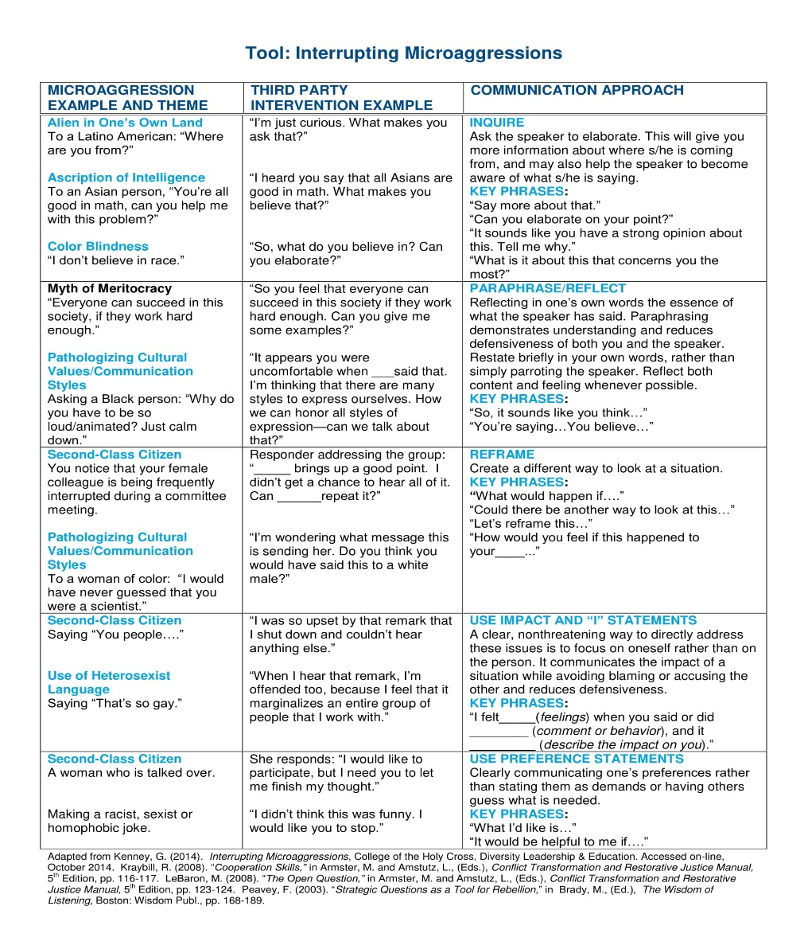
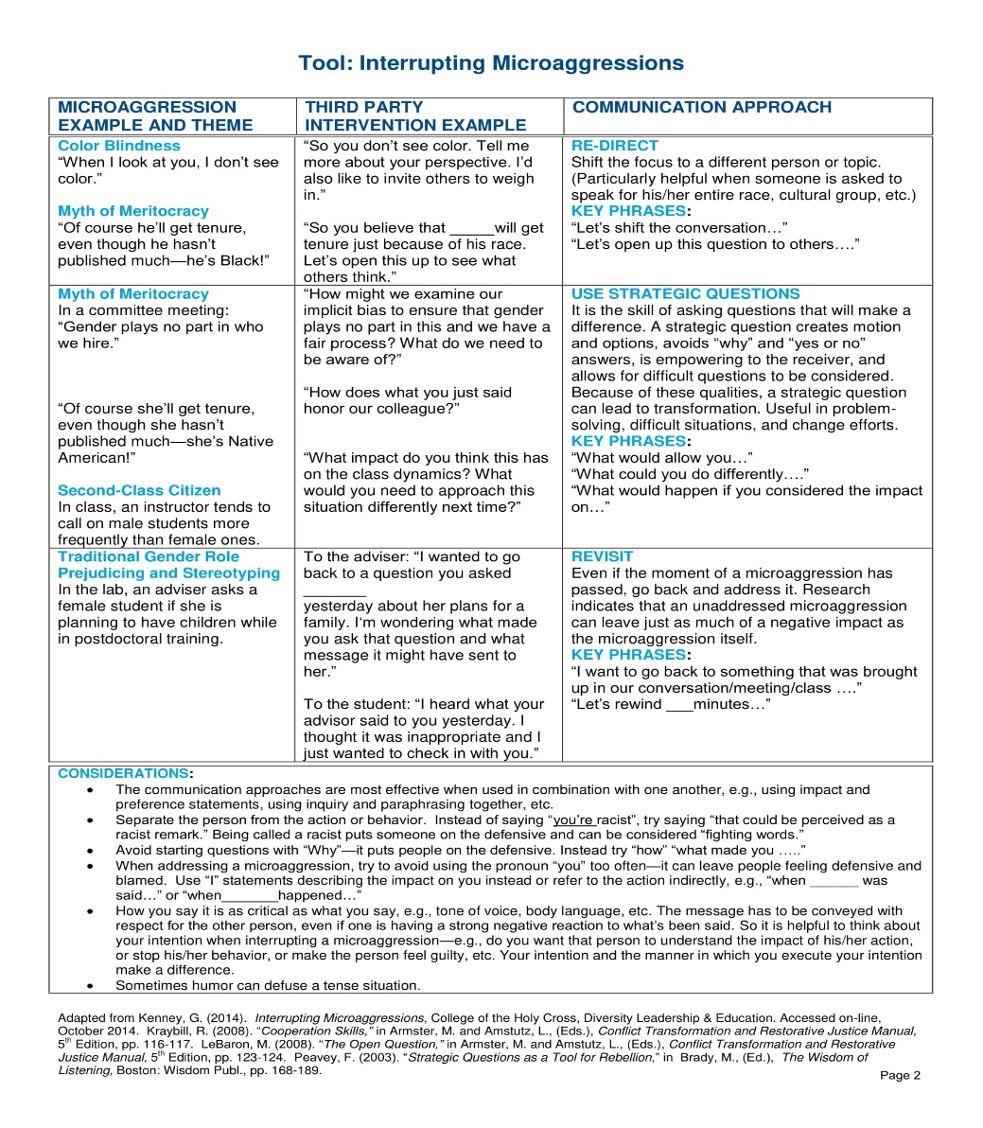
Responding to Microaggresions

Slide 17
Thank you!
Obie Ford III
obie3.ford@wsu.edu
360-546-9508
@ObieTheCDO
(Twitter, Facebook)

Slide 18
References
Castro, R. (2014). Small Acts of Kindness: Microaffirmations and Campus Climate. https://home.campusclarity.com/small-acts-of-kindness-micro-affirmations-and-campus-climate/
Dush, C.K. (2016). Fighting Back: Implicit Bias, Microaggressions, and Microresistance. http://u.osu.edu/adventuresinhdfs/2016/11/11/implicitbias/
Ely, E. (2017). Dr. Chester Pierce Understood Racism on Multiple Fronts. http://www.wbur.org/remembrance-project/2017/02/08/dr-chester-pierce
Kirkham, A. (2015). Why Microaggressions Hurt. http://everydayfeminism.com/2015/10/why-microaggressions-hurt/
Microaggressions: Power, Privilege, and Everyday Life. http://www.microaggressions.com/
Powell, C., Demetriou, C., Fisher, A. (2013). Microaffirmations in Academic Advising: Small Acts, Big Impact. https://dus.psu.edu/mentor/2013/10/839/
Sue, D.W. (2010). Microaggressions in Everyday Life: Race, Gender, and Sexual Orientation.

